Slide 1
Climate Change and Prosperity
Tackling many goals at once – don‘t ignore nuclear
Amardeo Sarma

Slide 2
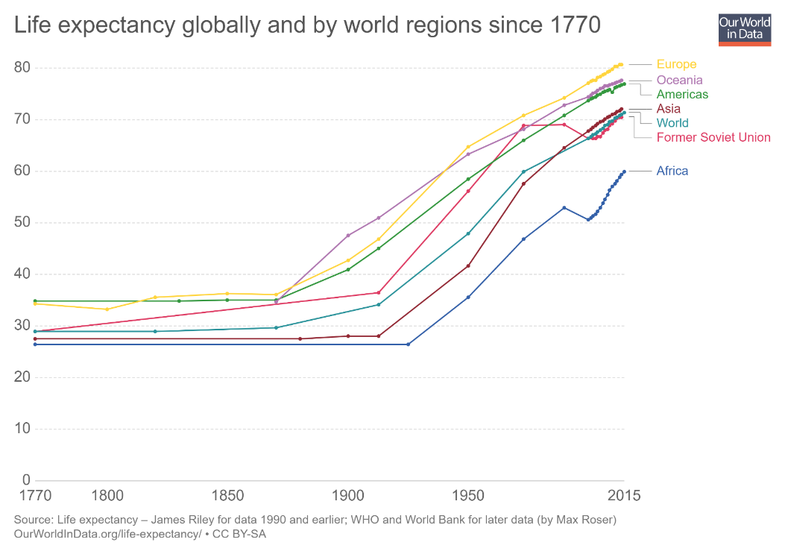
What modernity and energy has brought us
Higher life expectancy
Less absolute poverty
Better standard of living
Source: Our World in Data https://www.ourworldindata.org

Slide 3
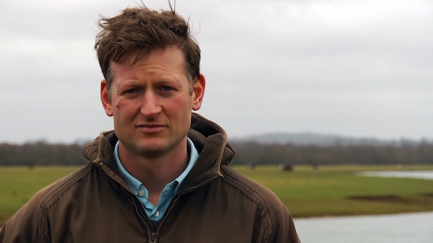
The problem – Upto Six Degrees?
Mark Lynas
Picture source: unknown author, license CC BY-SA-NC

Slide 4
What can we do to reduce emissions?
Wind power
Nuclear energy
Solar Power
Photovoltaics
Biopower
CCS
Source: IPCC

Slide 5
Misinformation from the German Government
Mourning the 18,000 victims of the Tohoku Earthquake and Tsunami as the victims of Fukushima
The real current debate is whether the number is 0 or 1

Slide 6
Germany‘s anti-nuclear policy
It was not always this way: Chancellor Helmut Schmidt 1979 shortly after the Charney Report: „We need nuclear power“ and talked of tackling incompetence , but:
He was ousted from power by no-confidence motion
Building nuclear slowed and stopped
Germany could be at the French level or better
Thousands of premature deaths (see Kharecha/Sato)
Strain on the stability of electricity production
Germany intimidates other EU countries to not develop nuclear power via the EU backed by old-school NGOs

Slide 7
A few days ago
https://www.electricitymap.org/map

Slide 8
What can be done in Germany
Keep repeating that Germany‘s failed energy policy with its nuclear phaseout harms the climate and health → Germany is not a role model in combating climate change
Confront false claims and fear-mongering around Chernobyl and especially Fukushima
Do all possible to stop Germany (and Austria) from interfering with the policies of other countries
Point to positive examples of countries that are doing much better, such as France and Ontario in Canada

